Slide 1
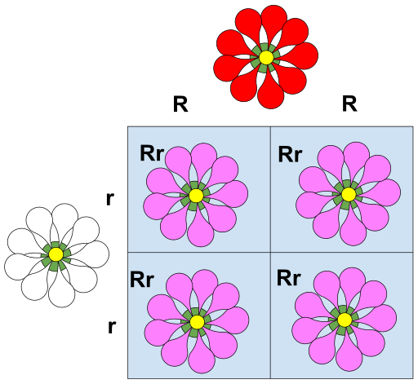
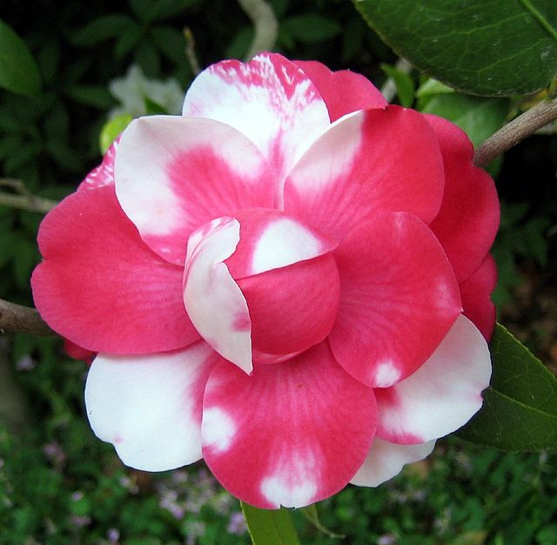
Codominance
The two alleles show an incomplete dominance (not required to know this term) relationship, where heterozygotes shows an intermediate/ blending characteristics.
https://biologydictionary.net/codominance/
IGCSE Biology
Codominance, in genetics, phenomenon in which two alleles (different versions of the same gene) are expressed to an equal degree within an organism. As a result, traits associated with each allele are displayed simultaneously (the heterozygote displays the phenotypic characteristics of both alleles).

Slide 2
Example – flower colour
Evidence of codominance:
Two codominant alleles can give three possible different phenotypes.
Heterozygotes shows an intermediate/ blending characteristics.
Genotype | Phenotype
C^{R} C^{R} | Red flowers
C^{R} C^{W} | Pink flowers
C^{W} C^{W} | White flowers

Slide 3
Example – cattle coat colour
In a breed of cattle, coat colour may be red, white or roan. Roan is a mixture of red and white hairs.
a) Choose suitable symbols for the alleles for red hair and white hair.
H^{R} = red hair, H^{W} = white hair.
b) Draw a table listing the three genotypes and the three phenotypes.
Genotypes: Phenotypes:
H^{R} H^{R} Red
H^{R} H^{W} Roan
H^{W} H^{W} White

Slide 4
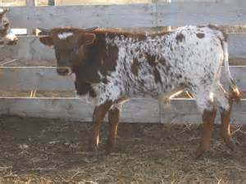
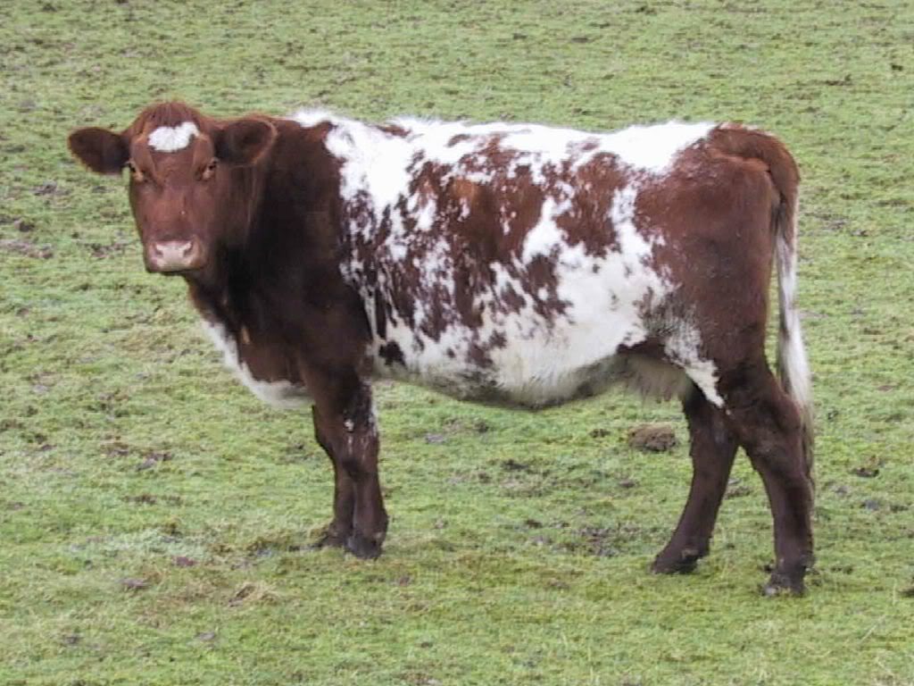
Example – cattle coat colour
c) Draw a genetic diagram to show the results of a cross between two roan cattle.

Slide 5
Example – cattle coat colour
Parents’ phenotype | Roan |  |  | Roan
Parents’ genotype | H^{R} H^{W} |  |  | H^{R} H^{W}
Alleles / Gametes | H^{R} H^{W} |  |  | H^{R} H^{W}
[The cross] |  | H^{R} | H^{W}
 | H^{R} | H^{R}H^{R} | H^{R}H^{W}
 | H^{W} | H^{R}H^{W} | H^{W}H^{W}
 |  |  |  | Ratios
F1 phenotypes | Red : Roan : White |  |  | 1:2:1
F1 genotypes | H^{R}H^{R} : H^{R}H^{W} : H^{W}H^{W} |  |  | 1:2:1

Slide 6
Example – cattle coat colour
1. Predict the phenotypic ratios of offspring when a homozygous white cow is crossed with a roan bull.
2. What should the genotypes & phenotypes for parent cattle be if a farmer wanted only cattle with red fur?
3. A cross between a black cat & a tan cat produces a tabby pattern (black & tan fur together).
a) What pattern of inheritance does this illustrate?
b) What percent of kittens would have tan fur if a tabby cat is crossed with a black cat?

Slide 7
Example – tomato leaves
In a variety of tomato plant, the leaves may be pure green, pure white or variegated.
a) Choose suitable symbols for the alleles involved.
L^{G} = green, L^{W} = white
b) When two variegated plants were crossed, 87 offspring were produced. Of these, 20 were green, 46 were variegated and the remaining 21 soon died after germination.
Draw a genetic diagram to explain these results. Why did 21 of the young plants die?

Slide 8
Example – tomato leaves
Parents’ phenotype | Variegated |  |  | Variegated
Parents’ genotype | L^{G}L^{W} |  |  | L^{G}L^{W}
Alleles / Gametes | L^{G} L^{W} |  |  | L^{G} L^{W}
[The cross] |  | L^{G} | L^{W}
 | L^{G} | L^{G}L^{G} | L^{G}L^{W}
 | L^{W} | L^{G}L^{W} | L^{W}L^{W}
 |  |  |  | Ratios
F1 phenotypes | Green : Variegated : White |  |  | 1:2:1
F1 genotypes | L^{G}L^{G} : L^{G}L^{W} : L^{W}L^{W} |  |  | 1:2:1
The 21 plants died because they had white leaves – so no chlorophyll. Without chlorophyll, there was no photosynthesis.

Slide 9
Blood types
Notes:
Many genes, however, are represented by multiple allelic forms within a population. (One individual, of course, can possess only two of these multiple alleles.) Human blood groups—in this case, the well-known ABO system—again provide an example. The gene that governs ABO blood types has three alleles: IA, IB, and IO. IA and IB are codominant, but IO is recessive.
Type A blood coagulates in the presence of A’(anti A) antibody

Slide 10
Example 1 – Blood groups
Draw a genetic diagram to show the possible blood groups of the children born to a man with blood group O and a woman with blood group AB.
Parents’ phenotype | Group O |  |  | Group AB
Parents’ genotype | I^{O}I^{O} |  |  | I^{A}I^{B}
Alleles / Gametes | I^{O} I^{O} |  |  | I^{A} I^{B}
[The cross] |  | I^{O} | I^{O}
 | I^{A} | I^{A}I^{O} | I^{A}I^{O}
 | I^{B} | I^{B}I^{O} | I^{B}I^{O}
 |  |  |  | Ratios
F1 phenotypes | Group A : Group B |  |  | 1:1
F1 genotypes | I^{A}Iº : I^{B}Iº |  |  | 1:1

Slide 11
Example 2 – Blood groups
A man with blood group A and a woman with blood group B had three children.
One child had blood group O, one had blood group A and one had blood group B.
Draw a genetic diagram to explain this.

Slide 12
Example 2 – Blood groups
Parents’ phenotype | Group A |  |  | Group B
Parents’ genotype | I^{A}I^{O} |  |  | I^{B}I^{O}
Alleles / Gametes | I^{A} I^{O} |  |  | I^{B} I^{O}
[The cross] |  | I^{A} | I^{O}
 | I^{B} | I^{A}I^{B} | I^{B}I^{O}
 | I^{O} | I^{A}I^{O} | I^{O}I^{O}
 |  |  |  | Ratios
F1 phenotypes | A : B : AB : O |  |  | 1:1:1:1
F1 genotypes | I^{A}I^{O} : I^{B}I^{O} : I^{A}I^{B} : I^{O}I^{O} |  |  | 1:1:1:1

